Slide 1
NETS 212: Scalable and Cloud Computing
PageRank and Adsorption
October 15, 2015
University of Pennsylvania

Slide 2
Announcements
Reminder: HW2 is due on October 20th
  Please start early!
  Don't wait until the last minute – take advantage of
  office hours!
University of Pennsylvania

Slide 3
Plan for today
PageRank
  Different formulations: Iterative, Matrix
  Complications: Sinks and hogs
  Implementation in MapReduce
Adsorption
  Label propagation
  Implementation in MapReduce
NEXT
University of Pennsylvania

Slide 4
Why link analysis?
Suppose a search engine processes a query for "team sports"
  Problem: Millions of pages contain these words!
  Which ones should we return first?
Idea: Hyperlinks encode a considerable amount of human judgment
  What does it mean when a web page links another page?
  Intra-domain links: Often created primarily for navigation
  Inter-domain links: Confer some measure of authority
So, can we simply boost the rank of pages with lots of inbound links?
University of Pennsylvania

Slide 5
Problem: Popularity ≠ relevance!
“A-Team”
page
Team
Sports
Hollywood
“Series to
Recycle” page
Mr. T’s
page
Cheesy TV
shows page
Yahoo
directory
Wikipedia
Shouldn't links from Yahoo and
Wikipedia "count more"?
University of Pennsylvania
Notes:
Suppose someone searches for 'team'

Slide 6
Other applications
This question occurs in several other areas:
  How do we measure the "impact" of a researcher?
  (#papers? #citations?)
  Who are the most "influential" individuals in a social network?
  (#friends?)
  Which programmers are writing the "best" code?
  (#uses?)
  ...
University of Pennsylvania

Slide 7
PageRank: Intuition
Shouldn't E's vote be
worth more than F's?
G
A
H
E
B
How many levels
should we consider?
I
C
F
J
D
Imagine a contest for The Web's Best Page
  Initially, each page has one vote
  Each page votes for all the pages it has a link to
  To ensure fairness, pages voting for more than one page must split their vote equally between them
  Voting proceeds in rounds; in each round, each page has the number of votes it received in the previous round
  In practice, it's a little more complicated - but not much!
University of Pennsylvania

Slide 8
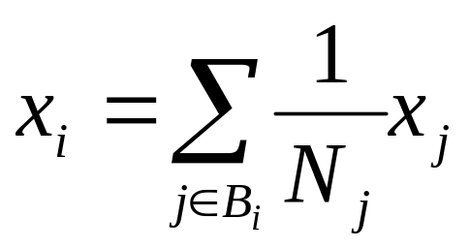
PageRank
Each page i is given a rank x_{i}
Goal: Assign the x_{i} such that the rank of each page is governed by the ranks of the pages linking to it:
Rank of page i
Rank of page j
Number of
links out
from page j
How do we compute
the rank values?
Every page
j that links to i
University of Pennsylvania

Slide 9
Random Surfer Model
PageRank has an intuitive basis in random walks on graphs
Imagine a random surfer, who starts on a random page and, in each step,
  with probability d, klicks on a random link on the page
  with probability 1-d, jumps to a random page (bored?)
The PageRank of a page can be interpreted as the fraction of steps the surfer spends on the corresponding page
  Transition matrix can be interpreted as a Markov Chain
Reason
explained
later
University of Pennsylvania

Slide 10
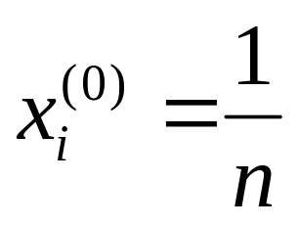
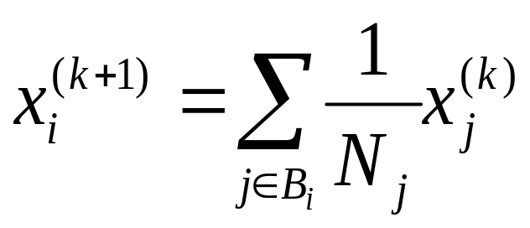
Iterative PageRank (simplified)
Initialize all ranks to
be equal, e.g.:
Iterate until
convergence
No need to decide
how many levels
to consider!
University of Pennsylvania

Slide 11
Example: Step 0
Initialize all ranks
to be equal
0.33
0.33
0.33
University of Pennsylvania

Slide 12
Example: Step 1
Propagate weights
across out-edges
0.33
0.17
0.33
0.17
University of Pennsylvania

Slide 13
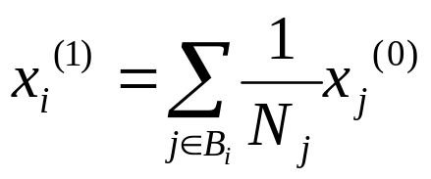
Example: Step 2
Compute weights
based on in-edges
0.50
0.33
0.17
University of Pennsylvania

Slide 14
Example: Convergence
0.4
0.4
0.2
University of Pennsylvania

Slide 15
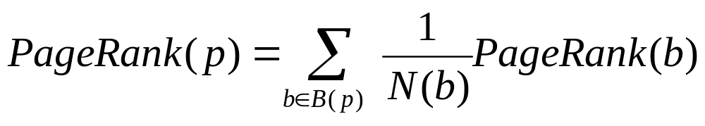
Naïve PageRank Algorithm Restated
Let
  N(p) = number outgoing links from page p
  B(p) = number of back-links to page p
  Each page b distributes its importance to all of the pages it points to (so we scale by 1/N(b))
  Page p’s importance is increased by the importance of its back set
University of Pennsylvania

Slide 16
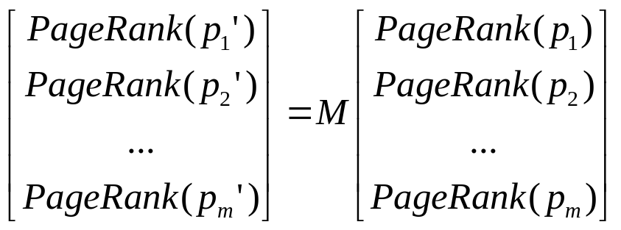
In Linear Algebra formulation
Create an m x m matrix M to capture links:
  M(i, j) = 1 / n_{j} if page i is pointed to by page j
  and page j has n_{j} outgoing links
  = 0 otherwise
  Initialize all PageRanks to 1, multiply by M repeatedly until all values converge:
  Computes principal eigenvector via power iteration
University of Pennsylvania

Slide 17
A brief example
Google
g'
y’
a’
0 | 0.5 | 0.5
0 | 0 | 0.5
1 | 0.5 | 0
g
y
a
=
*
Amazon
Yahoo
Running for multiple iterations:
g
y
a
1
1
1
1
0.5
1.5
1
0.75
1.25
1
0.67
1.33
=
,
,
, …
Total rank sums to number of pages
University of Pennsylvania

Slide 18
Oops #1
– PageRank sinks
g'
y’
a’
0 | 0 | 0.5
0.5 | 0 | 0.5
0.5 | 0 | 0
g
y
a
Google
=
*
Amazon
Yahoo
'dead end' - PageRank
is lost after each round
Running for multiple iterations:
g
y
a
1
1
1
0.5
1
0.5
0.25
0.5
0.25
0
0
0
=
,
,
, … ,
University of Pennsylvania

Slide 19
Oops #2
– PageRank hogs
Google
g'
y’
a’
0 | 0 | 0.5
0.5 | 1 | 0.5
0.5 | 0 | 0
g
y
a
=
*
Amazon
Yahoo
PageRank cannot flow
out and accumulates
Running for multiple iterations:
g
y
a
1
1
1
0.5
2
0.5
0.25
2.5
0.25
0
3
0
=
,
,
, … ,
University of Pennsylvania

Slide 20
Stopping the Hog
Google
g'
y’
a’
0 | 0 | 0.5
0.5 | 1 | 0.5
0.5 | 0 | 0
g
y
a
0.15
0.15
0.15
= 0.85
*
+
Amazon
Yahoo
Running for multiple iterations:
g
y
a
0.57
1.85
0.57
0.39
2.21
0.39
0.32
2.36
0.32
0.26
2.48
0.26
,
,
, … ,
,
=
… though does this seem right?
University of Pennsylvania

Slide 21
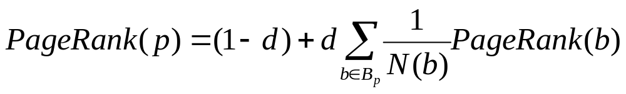
Improved PageRank
Remove out-degree 0 nodes (or consider them to refer back to referrer)
Add decay factor d to deal with sinks
Typical value: d=0.85
Intuition in the idea of the “random surfer”:
  Surfer occasionally stops following link sequence and jumps to new random page, with probability 1 - d
University of Pennsylvania

Slide 22
PageRank on MapReduce
Inputs
  Of the form: page → (currentWeightOfPage, {adjacency list})
Map
  Page p “propagates” 1/N_{p} of its d * weight(p) to the destinations of its out-edges (think like a vertex!)
  Output adjacency list
Reduce
  Page p sums the incoming weights and adds (1-d), to get its weight’(p)
Iterate until convergence
  Common practice: run some fixed number of times, e.g., 25x
  Alternatively: Test after each iteration with a second MapReduce job, to determine the maximum change between old and new weights
Notes:
Re-emphasize "Think like a vertex"
Do the 'diff' job on the board?
map(key : nodeID, value : float) {
emit(nodeID, value);
}
reduce(key : nodeID, values[] : float[]) {
if (abs(values[0]-values[1])>threshold)
emit("Not converged", "");
}

Slide 23

Plan for today
PageRank
  Different formulations: Iterative, Matrix
  Complications: Sinks and hogs
  Implementation in MapReduce
Adsorption
  Label propagation
  Implementation in MapReduce
NEXT
University of Pennsylvania

Slide 24
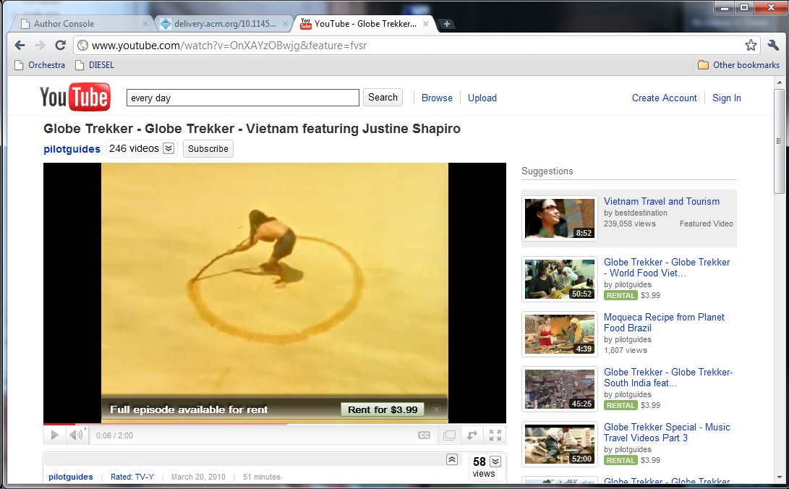
YouTube Suggestions
What can we leverage to make such recommendations?

Slide 25
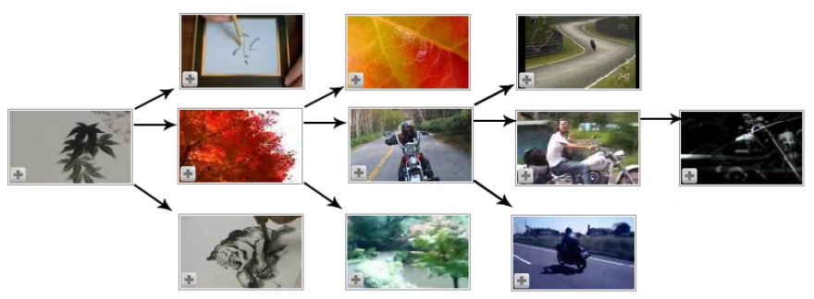
Co-views: Video-video
Idea #1: Keep track of which videos are frequently watched together
  If many users watched both video A and video B, then A should be recommended to users who have viewed B, and vice versa
  If there are many such videos, how can we rank them?
Notes:
Ranking: Section 1.1 in the paper (http://static.googleusercontent.com/external_content/untrusted_dlcp/research.google.com/en/us/pubs/archive/34407.pdf) suggests number of views, numebr of co-views, number of times a video is recommended based on other videos, and combinations of these
Might even restrict co-views to videos seen in the same web session

Slide 26
Co-Views: User-video
Idea #2: Leverage simi-larities between users
  If Alice and Bob have both watched videos A, B, and C, and Alice has additionally watched video D, then perhaps D will interest Bob too?
How can we see that in the graph?
  Short path between two videos
  Several paths between 2 videos
  Paths that avoid high-degree nodes in the graph (why?)
Users
Videos
1
A
2
3
B
4
5
C
6
D
7
8
E
9
10
11

Slide 27
More sophisticated link analysis
PageRank computes a stationary distribution for the random walk: the probability is independent of where you start
  One authority score for every page
But here we want to know how likely we are to end up at video j given that we started from user i
  e.g., what are the odds that user i will like video j?
  this is a probability conditioned on where you start

Slide 28
Video-video and user-video combined
Vietnam Tr.
Alice
?
Globe Trekker
Bob
SE Asia Tour
Our task:
  Take the video-video co-views and the user-video co-views
  (potentially annotated with weights)
  Assign to each video a score for each user, indicating the likelihood the user will want to view the video

Slide 29
Adsorption: Label propagation
Adsorption: Adhesion of atoms, ions, etc. to a surface
  The adsorption algorithm attempts to “adhere” labels and weights to various nodes, establishing a connection
There are three equivalent formulations of the method:
  A random walk algorithm that looks much like PageRank
  An averaging algorithm that is easily MapReduced
    This is the one we'll focus on
  A linear systems formulation

Slide 30
Adsorption as an iterative average
Easily MapReducible
Pre-processing step:
  Create a series of labels L, one for each user or entity
  Take the set of vertices V
  For each label l in L:
    Designate an “origin” node v_{l} (typically given node label l)
    Annotate it with the label l and weight 1.0
  Much like what we do in PageRank to start

Slide 31
Adsorption: Propagating labels
0.6
Vietnam Trekking
A: 1.0
Alice
0.5
0.4
0.5
0.33
0.33
Global Trekking
0.8
B: 1.0
Bob
0.33
0.2
1.0
SE Asia Tour
Iterative process:
  Compute the likelihood for each vertex v that a user x, in a random walk, will arrive at v – call this the probability of
  l_{x} ∈ L associated with node v

Slide 32
Adsorption: Propagating labels
A: 0.6
0.6
Vietnam Trekking
Alice
0.5
Distribute labels
+ weights to edges
0.4
A: 0.4
0.5
0.33
0.33
Global Trekking
B: 0.8
0.8
Bob
0.33
0.2
1.0
SE Asia Tour
B: 0.2
Iterative process:
  Compute the likelihood for each vertex v that a user x, in a random walk, will arrive at v – call this the probability of
  l_{x} ∈ L associated with node v

Slide 33
Adsorption: Propagating labels
A: 0.6
0.6
Vietnam Trekking
Alice
0.5
Assign node labels
& weights by summing
0.4
0.5
0.33
A: 0.4
0.33
Global Trekking
0.8
B: 0.8
Bob
0.33
Normalize
node weights so they sum
to 1.0
0.2
1.0
SE Asia Tour
B: 0.2
Iterative process:
  Compute the likelihood for each vertex v that a user x, in a random walk, will arrive at v – call this the probability of
  l_{x} ∈ L associated with node v

Slide 34
Adsorption: Propagating labels
0.6
Vietnam Trekking
Alice
0.5
A: 0.3
0.4
A: 0.3
0.5
0.33
A: 0.13
B: 0.26
B: 0.26
A: 0.13
0.33
Global Trekking
0.8
Bob
0.33
A: 0.13
B: 0.26
Divide & propagate
weights along edges
in each direction
0.2
1.0
SE Asia Tour
B: 0.2
Iterative process:
  Compute the likelihood for each vertex v that a user x, in a random walk, will arrive at v – call this the probability of
  l_{x} ∈ L associated with node v

Slide 35
Adsorption: Propagating labels
A: 0.13
0.6
Vietnam Trekking
A: 0.43
B: 0.26
Alice
0.5
0.4
0.5
0.33
B: 0.26
A: 0.3
0.33
Global Trekking
0.8
A: 0.13
Bob
Assign node labels
& weights by summing
0.33
0.2
B: 0.46
1.0
SE Asia Tour
Iterative process:
  Compute the likelihood for each vertex v that a user x, in a random walk, will arrive at v – call this the probability of
  l_{x} ∈ L associated with node v

Slide 36
Adsorption: Propagating labels
B: 0.16
A: 0.26
0.6
Vietnam Trekking
Alice
0.5
B: 0.13
A: 0.06
0.4
A: 0.06
0.5
0.33
A: 0.1
A: 0.17
B: 0.10
B: 0.13
A: 0.1
0.33
Global Trekking
0.8
A: 0.10
B: 0.36
Bob
0.33
A: 0.1
Repeat...
0.2
A: 0.03
B: 0.10
1.0
SE Asia Tour
Iterative process:
  Compute the likelihood for each vertex v that a user x, in a random walk, will arrive at v – call this the probability of
  l_{x} ∈ L associated with node v

Slide 37
Adsorption: Propagating labels
A: 0.36
0.6
Vietnam Trekking
A: 0.16
Alice
0.5
B: 0.16
0.4
0.5
0.33
B: 0.13
A: 0.33
0.33
Global Trekking
0.8
B: 0.59
Bob
0.33
0.2
A: 0.03
A: 0.1
1.0
SE Asia Tour
B: 0.10
... until
convergence
Iterative process:
  Compute the likelihood for each vertex v that a user x, in a random walk, will arrive at v – call this the probability of
  l_{x} ∈ L associated with node v

Slide 38
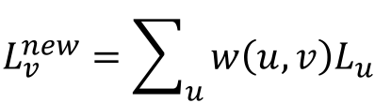
Adsorption algorithm formulation
Inputs: G = (V, E, w) where w : E → ℜ;
  L: set of labels; V_{L} ⊆ V: nodes with labels
Repeat
  foreach v ∈ V do
  normalize L_{v} to have unit L₁ norm
until convergence
Output: Distributions {L_{v} | v ∈ V}
Notes:
Potential source of confusion: this formulation doesn't do the two steps (vertex->edges and edges->vertex) separately – it simply sums up across all source vertexes and multiplies with the edge weight (which could be zero for vertex pairs that aren't connected by an edge)

Slide 39
Applications of Adsorption
Recommendation (YouTube)
Discovering relationships among data:
  Classifying types of objects
  Finding labels for columns in tables
  Finding similar / related concepts in different tables or
  Web pages
Notes:
Relationships: Talukdar thesis 2010, advised by Zack Ives and Fernando Pereira

Slide 40
Recap and Take-aways
We’ve had a whirlwind tour of common kinds of algorithms used on the Web
  Path analysis: route planning, games, keyword search, etc.
  Clustering and classification: mining, recommendations, spam filtering, context-sensitive search, ad placement, etc.
  Link analysis: ranking, recommendations, ad placement
Many such algorithms (though not all) have a reasonably straightforward, often iterative, MapReduce formulation

Slide 41
Next time
We’ve talked in depth about cloud Platform-as-a-Service capabilities
We’ll see in detail how to build Software-as-a-Service
  Dynamic HTML / AJAX
  Node.js, and possibly Java servlets

Slide 42

Stay tuned
Next time you will learn about:
Iterative processing
University of Pennsylvania

Slide 43

Backup slides
Here be dragons
University of Pennsylvania

Slide 44
Preview: Other layers
University of Pennsylvania

Slide 45
Trends at this year's OSDI
SOSP+OSDI: The top systems conferences
  Each is held only once every two years
Sessions this year at OSDI:
  Kernels: Past, Present, and Future
  Inside the Data Center, 1
  Security Technologies
  Concurrency Bugs
  Deterministic Parallelism
  Systems Management
  Inside the Data Center, 2
  Cloud Storage
  Production Networks
  Mobility
  Virtualization
New storage system (Facebook)
Storage availability study (Google)
Data mgmt/provenance (MSR SV)
Incremental data processing (Google)
MapReduce outliers (MSR/Berkeley)
Consistency/caching (MIT)
New programming model (NYU)
Untrusted storage (UT Austin)
Active key-value store (UW)
Untrusted cloud resources (Princeton)
University of Pennsylvania

Slide 46
A few relevant papers from OSDI
Haystack: Facebook's photo store
  Describes the storage system that is currently handling Facebook's 260 billion images
  http://www.usenix.org/events/osdi10/tech/full_papers/Beaver.pdf
Percolator: System for incremental processing
  Google constantly recrawls small portions on the web, but doesn't want to rebuild the entire index via MapReduce
  Instead: Incremental updates
  ACID-compliant transactions! Is Google moving away from loose consistency?
  http://www.usenix.org/events/osdi10/tech/full_papers/Peng.pdf
University of Pennsylvania

Slide 47
Trends at this year's SOSP
SOSP+OSDI: The top systems conferences
  Each is held only once every two years
Sessions this year at OSDI:
  xxx
New storage system (Facebook)
Storage availability study (Google)
Data mgmt/provenance (MSR SV)
Incremental data processing (Google)
MapReduce outliers (MSR/Berkeley)
Consistency/caching (MIT)
New programming model (NYU)
Untrusted storage (UT Austin)
Active key-value store (UW)
Untrusted cloud resources (Princeton)
University of Pennsylvania

Slide 48
A few relevant papers from SOSP
Entire session on key-value stores (3 papers)
  SILT: A Memory-Efficient, High-Performance Key-Value Store
  Scalable Consistency in Scatter
  Fast Crash Recovery in RAMCloud
Paper on Windows Azure storage
  Windows Azure Storage: A Highly Available Cloud Storage Service with Strong Consistency
Two papers on Geo-Replication
  Transactional storage for geo-replicated systems
  Don’t Settle for Eventual: Scalable Causal Consistency for Wide-Area Storage with COPS
University of Pennsylvania

Slide 49
Recall
Last time: building a toolbox of algorithms
  Graph encodings
  Path-based algorithms – single-source shortest path
Clustering and classification
  k-means clustering

Slide 50
Trends at this year's SOSP
SOSP+OSDI: The top systems conferences
  Each is held only once every two years
Sessions at this year's conference:
  Key-Value
  Storage
  Security
  Reality
  Virtualization
  OS Architecture
  Detection and Tracing
  Threads and Races
  Geo-Replication
High-performance KVS (CMU)
Scalable consistency (UW)
Fast KVS crash recovery (Stanford)
Windows Azure Storage (Microsoft)
Our SNP paper (more on 11/17, 3pm!)
Transactional wide-area storage (NYU)
Scalable causal consistency (Princeton)
University of Pennsylvania

